Slide 1



UNIVERSITY INSTITUTE OF ENGINEERING
COMPUTER SCIENCE ENGINEERING
Bachelor of Engineering
Design and Analysis of Algorithms(CST-302/ITT-302)
Prepared By: Amrita Chaudhary (E8745)
Topic: Stack
DISCOVER . LEARN . EMPOWER

Slide 2
Learning Objectives & Outcomes
Objective:
To understand the meaning of Stack and what are its operations.
Outcome:
Student will understand
stacks and its operations.
Application of Stack

Slide 3
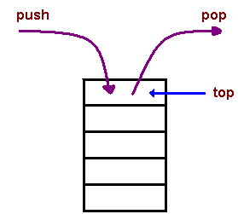
Stack
Stack is a linear data structure which follows a particular order in which the operations are performed. The order may be LIFO(Last In First Out) or FILO(First In Last Out).

Slide 4
Stack operations
Two Basic operations are performed in the stack:
PUSH: Inserting an element into the stack
POP: Deleting an element from the stack
When data is PUSHed onto stack
Check the status of stack by following functionality is added to stacks −
peek() − Get the topmost item of the stack, without removing it.
isFull() − check if stack is full.
isEmpty() − check if stack is empty.

Slide 5

How to understand stack practically?
There are many real life example of stack . Considered the sample example of plates stacked over one another in canteen.
The plate which is at the top is the first one to remove i.e. the plate which has been placed at the bottom position in the stack for the longest period of time.
So, it can be simply seen to follow LIFO/FILO order.

Slide 6
Implementation
There are two ways to implement a stack :
Using Array
Using Linked List

Slide 7
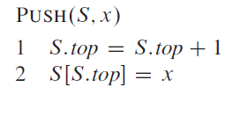
Push Operation
Step 1 − Checks if the stack is full.
Step 2 − If the stack is full, produces an error and exit.
Step 3 − If the stack is not full, increments top to point next empty space.
Step 4 − Adds data element to the stack location, where top is pointing.
Step 5 − Returns success.

Slide 8
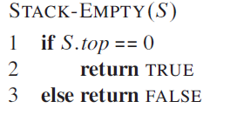
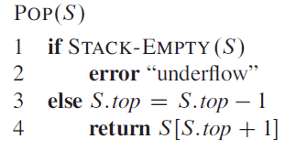
Pop Operation
Step 1 − Checks if the stack is empty.
Step 2 − If the stack is empty, produces an error and exit.
Step 3 − If the stack is not empty, accesses the data element at which top is pointing.
Step 4 − Decreases the value of top by 1.
Step 5 − Returns success.

Slide 9
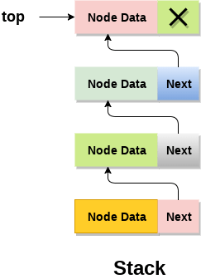
Linked list implementation of stack
Linked list allocates the memory dynamically.
The top most node in the stack always contains null in its address field. Lets discuss the way in which, each operation is performed in linked list implementation of stack.

Slide 10
push - Inserting an element into the Stack
We can use the following steps to insert a new node into the stack...
Step 1 - Create a newNode with given value.
Step 2 - Check whether stack is Empty (top == NULL)
Step 3 - If it is Empty, then set newNode → next = NULL.
Step 4 - If it is Not Empty, then set newNode → next = top.
Step 5 - Finally, set top = newNode.

Slide 11
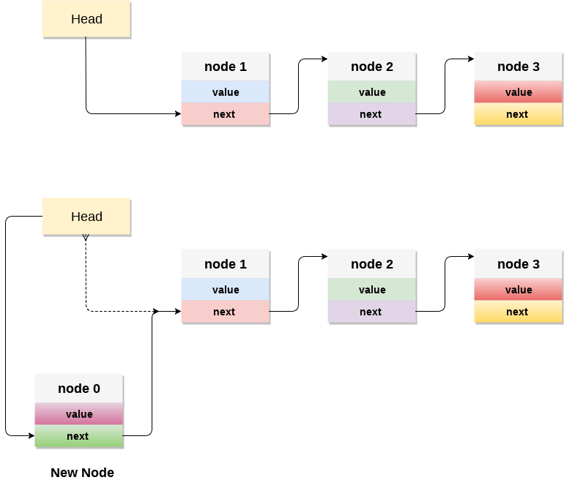
Example of PUSH Operation

Slide 12
pop() - Deleting an Element from a Stack
We can use the following steps to delete a node from the stack...
Step 1 - Check whether stack is Empty (top == NULL).
Step 2 - If it is Empty, then display "Stack is Empty!!! Deletion is not possible!!!" and terminate the function
Step 3 - If it is Not Empty, then define a Node pointer 'temp' and set it to 'top'.
Step 4 - Then set 'top = top → next'.
Step 5 - Finally, delete 'temp'. (free(temp)).

Slide 13
display() - Displaying stack of elements
We can use the following steps to display the elements (nodes) of a stack...
Step 1 - Check whether stack is Empty (top == NULL).
Step 2 - If it is Empty, then display 'Stack is Empty!!!' and terminate the function.
Step 3 - If it is Not Empty, then define a Node pointer 'temp' and initialize with top.
Step 4 - Display 'temp → data --->' and move it to the next node. Repeat the same until temp reaches to the first node in the stack. (temp → next != NULL).
Step 5 - Finally! Display 'temp → data ---> NULL'.

Slide 14
Applications of Stack
The simplest application of a stack is to reverse a word. You push a given word to stack - letter by letter - and then pop letters from the stack.
There are other uses also like:
  Parsing
  Expression Conversion(Infix to Postfix, Postfix to Prefix etc)

Slide 15
REFERENCES
Text books:
Cormen, Leiserson, Rivest, Stein, “Introduction to Algorithms”, Prentice Hall of India, 3rd edition 2012. problem, Graph coloring.
Horowitz, Sahni and Rajasekaran, “Fundamentals of ComputerAlgorithms”, University Press (India), 2nd edition
Websites:
https://gradeup.co/stacks-i-12d755b7-c59a-11e5-9776-de767a2dfd2a
https://www.geeksforgeeks.org/stack-data-structure/
https://www.javatpoint.com/ds-linked-list-implementation-of-stack#:~:text=Linked%20list%20allocates%20the%20memory,successor%20node%20in%20the%20stack.

Slide 16
Summary
Stacks:
  Operations and basic features of stack
  Implementation of stack
  Application of stack

Slide 17
THANK YOU

